Slide 1


Looking Forward….The best is yet to come
2024 – 2025 Annual General Meeting
Vernon Jubilee Hospital Medical Staff Association

Slide 2

First Nations Land Acknowledgement
We are grateful for our presence on the traditional, ancestral, unceded land of the Syilx Okanagan people who have reside here since time immemorial.
We recognize, honour and respect these beautiful Syilxx Okanagan lands upon which we live, work and play.

Slide 3
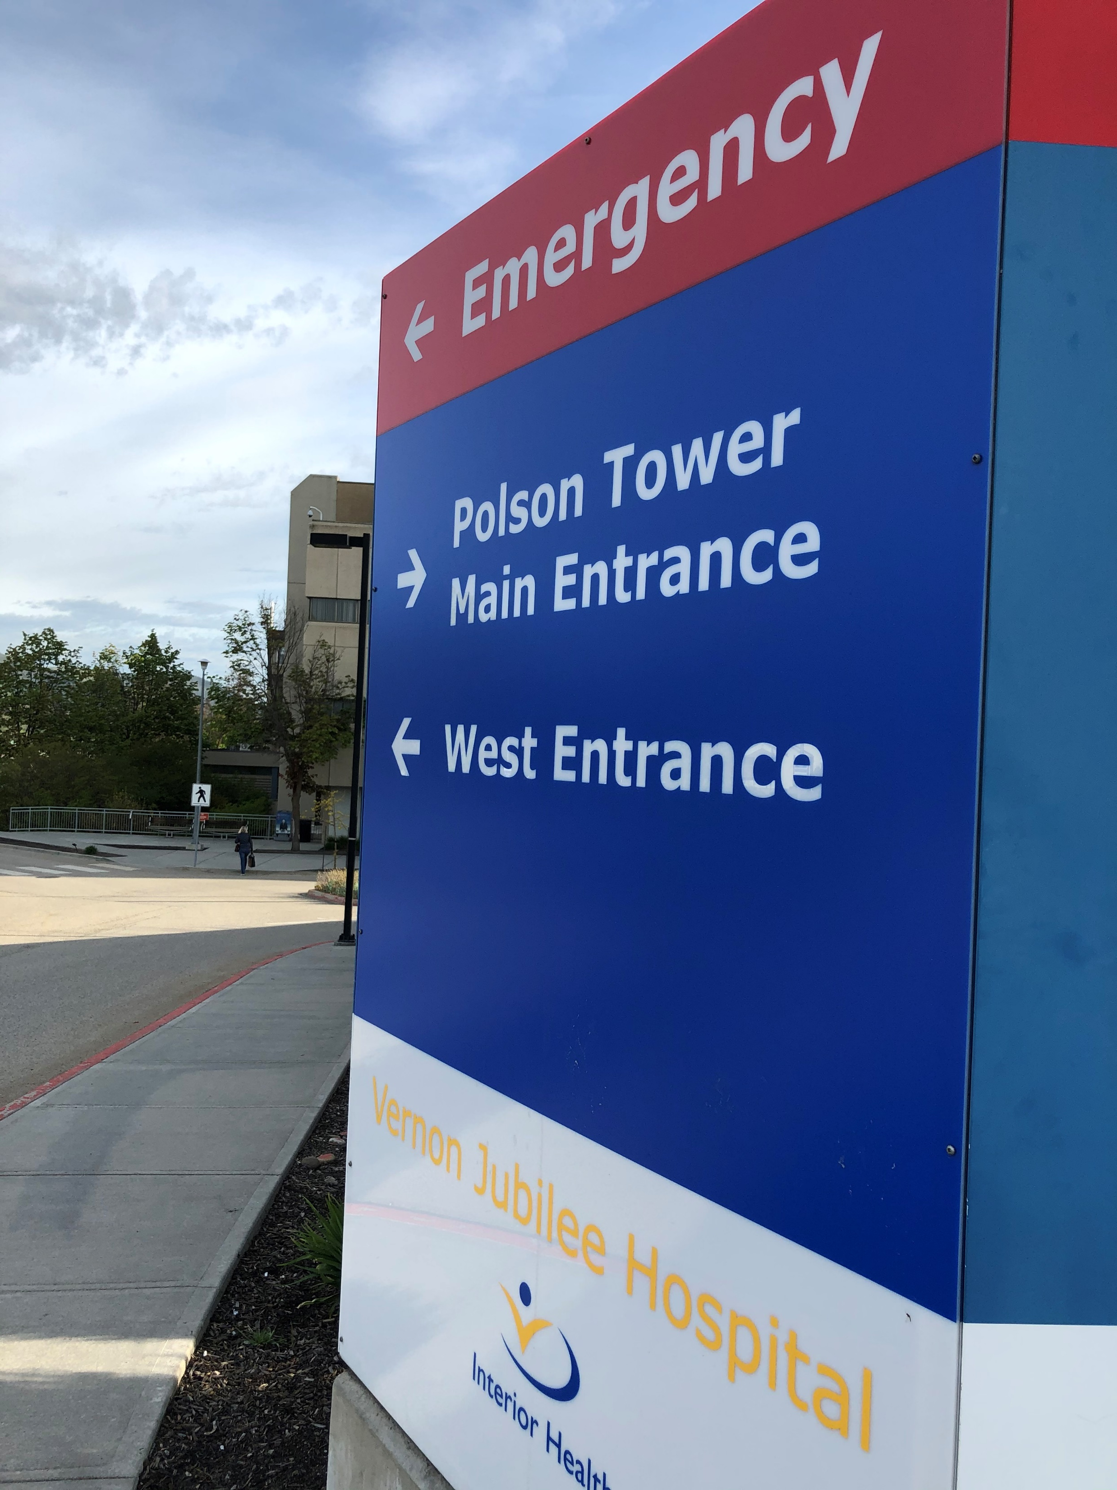
Annual General Meeting
April 1, 2024 – March 31, 2025

Slide 4
VJH MSA: Your voice in healthcare
MSA Executive
Elected. Maximum 7 members. Meets monthly via Zoom
Responsible for: Governance, Financial Stewardship, Facility Engagement
Manages $400,000 (Doctors of BC) and MSA physician dues
MSA Working Group
Department representatives and at least one executive member
Meets in person every second month
Responsible for: approval of projects over $5,000, implementing the strategic plan, bringing forward issues impacting members

Slide 5
Strategic Pillars
Physician Engagement
Physician Development
(Leadership & Wellness)
Quality Improvement
Attraction, Recruitment and Retention of Top Talent

Slide 6
VJH MSA: 2024-2025
Executive
Dr. Kira McClellan
Dr. Jennifer Smith
Dr. Sergei Reznikov
Dr. Yann Brierley
(Dr. Jason Doyle)
Sharon Hughes-Geekie
Taylor Blake (Recording Secretary)
Working Group
Executive Members
Dr. Laurent Gagne-Brosseau
Dr. Quinn Parker
Dr. Taylor Jesperson
Dr. Leanne Hewitson
Dr. Kevin Stevenson
Dr. Eric Pond
Dr. Shannon Rourke
Dr. Timothy Watkins
RM Julia Bailey
Dr. Chris Cunningham
Dr. Bill Haring – Doctors of BC Engagement Partner

Slide 7
Medical Staff Dues
Members | Number Paid | Dues Charged ($) | Total ($)
Active Physicians 2024 2023 | 124 130 | $200 $200 | $25,600 $26,000
Associate/Temporary Midwives Nurse Practitioners | 51 43 | $100 $100 | $5,100 $4,300
TOTAL less admin fees | 175 173 |  | $30,700 $30,300

Slide 8
MSA Financials
Opening Balance:
MSA - $38,841
Physician Waffle House - $3,000
Revenue:
Physician Dues/Events - $32,019.60
Physician Waffle House - $20,000.00
Civility Matters - $8,097.61
Expenses:
MSA - $45,778.83
Physician Waffle House - $21,375.69
Civility Matters - $3,579.37
Closing Balance:
MSA - $25,082
Physician Waffle House – $824.31
Civility matters - $5,318.25
Expenses:
Bank Charges - $72
GMS and Meetings - $4,749
Coffee Service Physician Lounge - $2,191
Donations - $10,000
Student Parking Passes - $3,000
Accounting Fees - $1,113
High School Scholarships - $5,000
Physician Family BBQ - $3,070
Mingle Jingle and Spring Gala - $16,583

Slide 9
 | 2025 | 2024
Doctors of BC Funding | $450,497 | $449,068
EXPENSES
Conference Fees | 641 | 5,963
Consultants | 110,139 | 31,661
Event Expense | 46 | 322
Interest and Bank Charges | 3,229 | 1428
Meals | 7,882 | 8,331
Member Time | 211,781 | 228,300
Miscellaneous | 0 | 1,413
Office | 25,820 | 18,910
Professional Fees | 6,375 | 6,111
Salaries & Wages (Board) | 29,563 | 31,635
Sub-Contract (now consultants) | 0 | 86,683
Website | 41,240 | 22,811
Travel (Dr. Chris Turner incl.) | 12,351 | 4,070
 | $450,497 | $449,068
VJH Physician Society Financial Statements

Slide 10
Civility Matters - $5,431
Communications – $10,743
CME -$1,749
Department/Interdepartmental Meetings -$63,031
Governance - $42,658.75
Internal Operating Expenses - $142,627
Kid Friendly ER Painting Project - $8,517
Leadership Toolkit - $9,910
Physician Recruitment - $34,790
Physician Waffle House - $21,362
Civility Regional Tour - $12,146
Resuscitation SIMS - $6,236
Strategic Planning Review – Pediatrics - $4,749
Uncompensated Committee Work - $69,262
Working Group - $19,603
Physician Society Activities
2024 - 2025

Slide 11
Election of MSA Board
Nominated:
Past President – Dr. Kira McClellan
Secretary/Treasurer – Dr. Sergei Reznikov
Directors:
Dr. Yann Brierley
Dr. Johannes Schreve
Dr. Jordan Koopman
Dr. Noura Safar
Are there nominations from the floor?

Slide 12
Motion: To elect the following to the VJH MSA Board of Directors. The role of president will be appointed at the first executive meeting on November 5.
Secretary/Treasurer – Dr. Sergei Reznikov
Past President – Dr. Kira McClellan
Directors:
Dr. Yann Brierley
Johannes Schreve
Dr. Jordan Koopman
Dr. Noura Safar

Slide 13
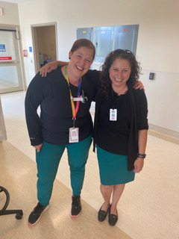
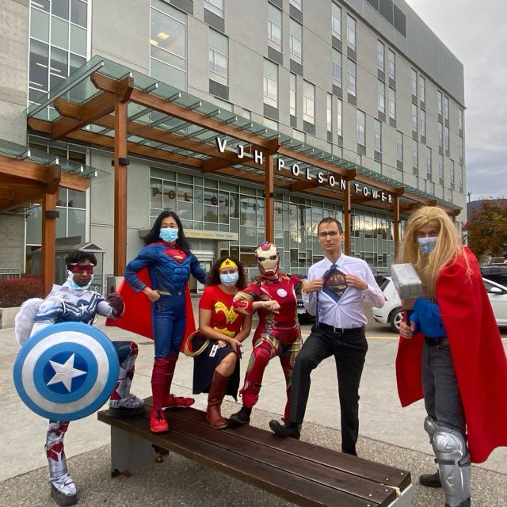
Be the Superhero - Support Staff & Save Kids
Building Teams for Early Intervention
Dr. Jody Snook & Krissy Krnasty, RN
Notes:
We invite you to be the superhero in supporting staff and saving kids. Our project looks at early intervention and building teamwork within local sites.
The site for our project was VJH. A regional site with one of the highest numbers of pediatric acuity within IH. VJH has 5 funded pediatric beds shared between medical, surgical, and mental health pediatric populations.

Slide 14
Pediatric Critical Care Outreach Team
Our Pitch to You!
What if there was a way to recognize signs of early deterioration in our pediatric patients and provide swift intervention to decrease Pediatric Codes?
While also decreasing staff stress, supporting our families with ill children, and providing high quality care?
And at the same time, you are building a supportive team network at your site - would you want to learn more?

Slide 15
Background
January 2022 to December 2023 alone VJH saw:
14% of regional pediatric admission to the adult ICU (20% in 2023-2024)
16, 902 ER presentations for acute pediatric care
192 pediatric traumas
Education offered and promoted with the rollout of Pediatric CCOT:
Pediatric Emergency Assessment, Recognition, and Stabilization (Heart & Stroke)
Pediatric Advanced Life Support (Heart & Stroke)
Pediatric Upskilling Plan (Interior Health)
We have a strong simulation and education program run at VJH that we have leveraged in rolling out Pediatric CCOT

Slide 16
Aim Statement
By the end of 2025, our primary aim is to see a decrease from baseline the need for ICU admissions or transfers to Higher Level Of Care by 30% for admitted patients, less than 17 years old, who demonstrate “early warning signs” for deterioration on WCHS by providing early critical care support.
By cohort end in May 2025, our secondary aim is to improve staff satisfaction on our involved units so that 90% of staff indicate they are satisfied or very satisfied with the Pediatric CCOT process.

Slide 17
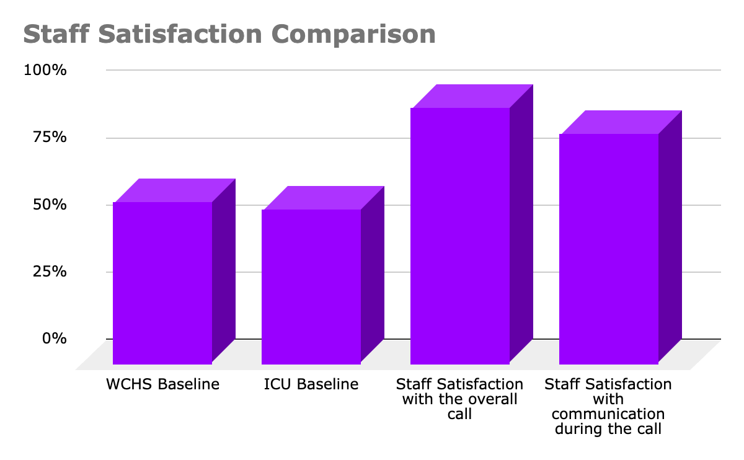
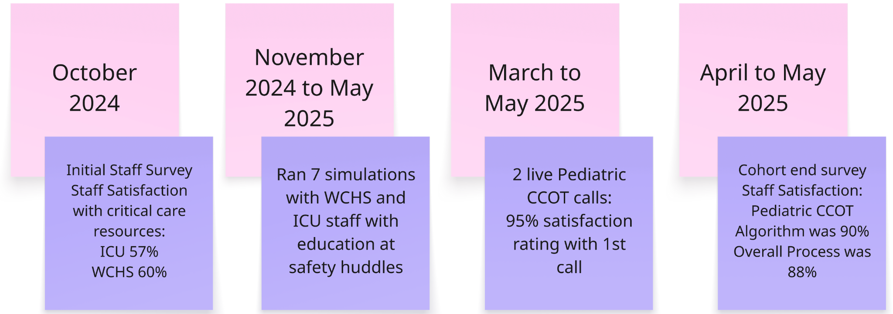




Our Project Drivers
We focused on the following:
Notes:
Early Critical Care Resources
the team developed an early intervention algorithm, developed a process that is coordinated with clear criteria for activation, s an initiation process with our switchboard and a documentation tool for nursing
Improved Patient/Family experience
We worked to ensure there was clear communication with the team, our social work team was supportive to attend when able to directly support parents/families, and we have developed some family based resources reviewed by our parent partner
We also highlighted the importance of utilizing parent/caregiver information as part of assessment - they are the experts on their children so wanted to highlight that the information they have to share is an important assessment piece.
Coordination of Care involves multiple team members
We involved hospital access and flow as team members
We involved the Most responsible provider early in the process to ensure timely consults, investigations and treatment
Initiating this process early allows us to look at local resource availability and the best location and team to care for that patient
Teamwork and Collaboration
As mentioned in our secondary aim we wanted to focus on improving staff satisfaction - all team members had representation on the working group and input on the design process
We recognize that critically ill children add an extra layer of stress for all staff involved and bring the added complexity of a family that is also under significant stress
Improving team communication means building relationships between the ICU and WCHS staff.
and doing this allows us to pull in all team members required for complex patient care
This is a snapshot to summarize some of our PDSA cycles with the data we have to date
What we want to highlight is the change from the initial survey to our first live call and our current state at the end of the cohort in our satisfaction ratings
To showcase this more clearly - this graph highlights the improvement we have seen in a few short months with this project with our baseline on the left - to the feedback following the first live call at the end of March on the right

Slide 18


Slide 19
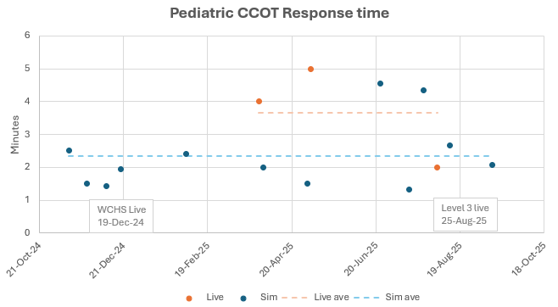

Slide 20
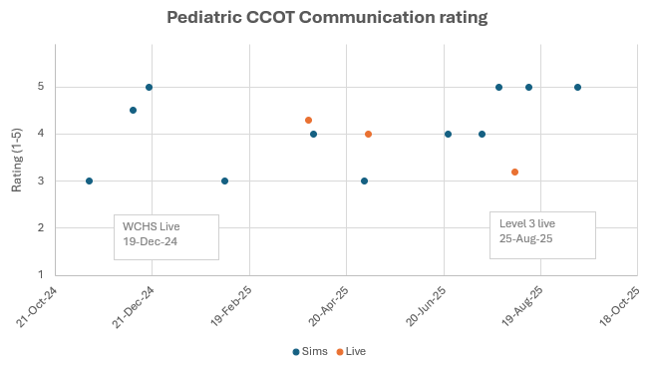

Slide 21
Key Learnings
Our project looks at high acuity but fortunately low frequency events so collection of live data will be slow
There have been challenges with lack of baseline data for the project
Social currency in healthcare is big - it takes time to build teams that learn and work well together; trust is not magical and needs to be earned
This project has been live between ICU and WCHS since December 19, 2024, and live between ICU and level 3 (OR, PACU, and SDC) since August 25, 2025. We are in discussions about a final roll out for the Youth Mental Health pod to finalize VJH.
We had a meeting on October 20, 2025, with Spread Quality Improvement to see if we are ready to spread this throughout Interior Health
We can be reached at VJHPCCOT@interiorhealth.ca
Notes:
We knew that collecting data would be a challenge and it will take time to see the long term impact from this project
We did not anticipate the limited data on number of Code Pink calls, transfers to HLOC or ICU admissions at our site.
Social currency in healthcare is big - we knew going in that building the team for this project would take time and will be an ongoing work in progress as team members change over time
We are hopeful that this project will improve Pediatric care for Interior Health and we feel that there should be equal access to resources like this at all our sites in the health authority
This project has reaffirmed the significance of standardized pediatric education across out health authority. In our short time we have witnessed that empowering staff with knowledge improves patient care.

Slide 22
Medical Staff Dues: Please Pay 2025/26 year to date
Number Paid Dues Charged Total
Physicians 72 $300 $21,600
1 $200 $ 200
Associate/Temporary
Midwives
Nurse Practitioners 81 $150 $12,150
154 $33,950
NOTE: $11,300 earmarked for Physician Navigator to assist with recruitment

Slide 23
Motion: To adjourn the 2024/25 VJH MSA Annual General Meeting
Thank you for attending this year’s
Annual General Meeting.

